Slide 1


Slide 2
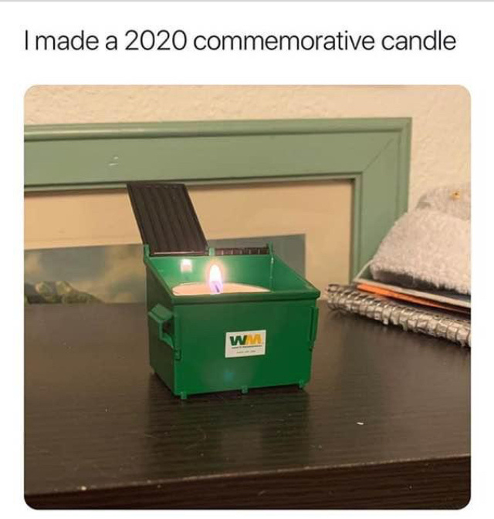

Slide 3
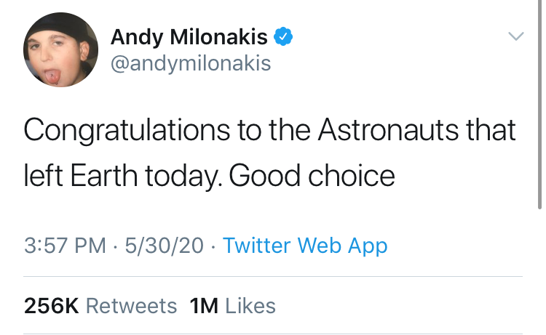

Slide 4
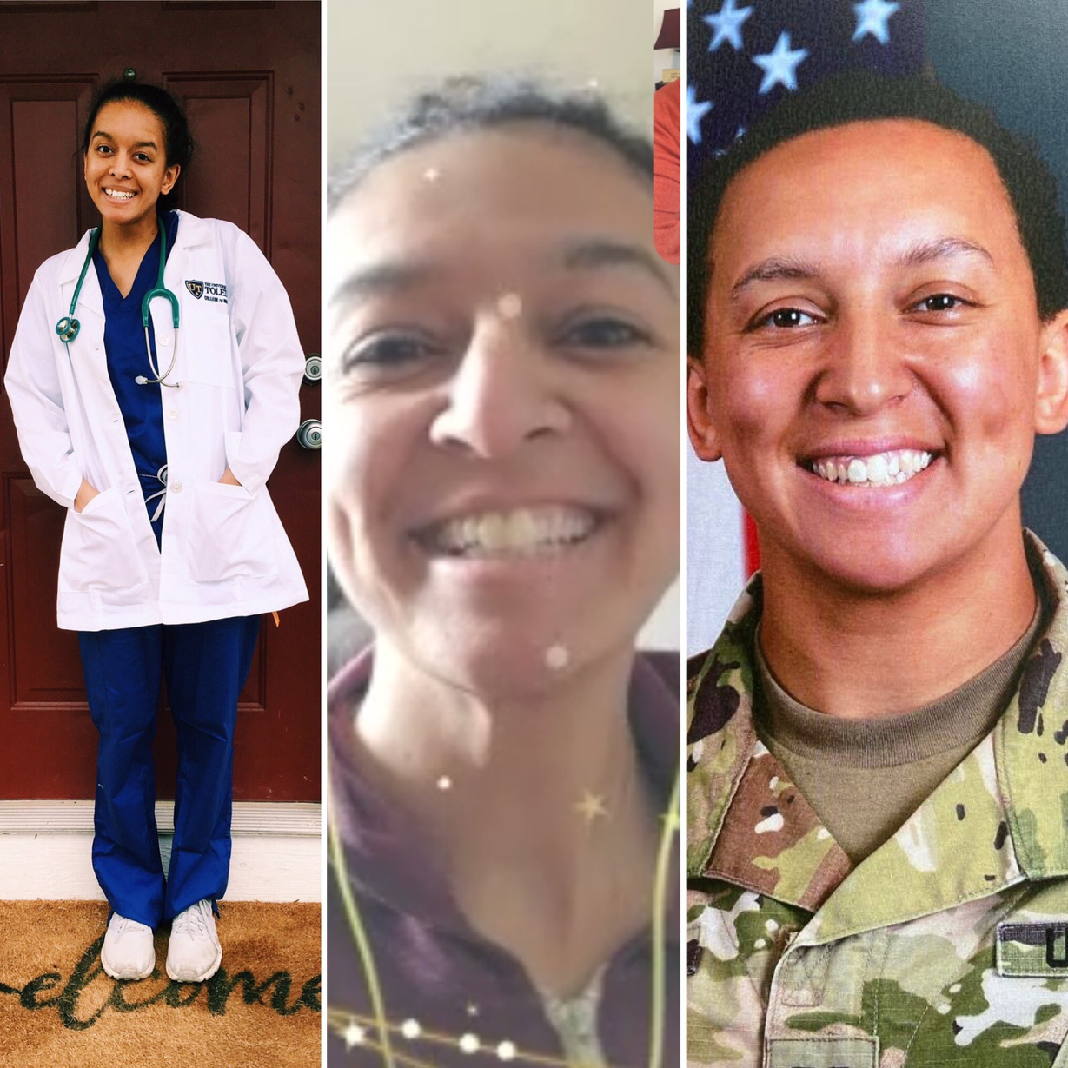

Slide 5
PERSPECTIVE
choose
what you
to see.

Slide 6
“If you look at the world,
you'll be distressed. If you look within, you'll be depressed. If you look at
you'll be at rest.”
God
Corrie Ten Boom

Slide 7
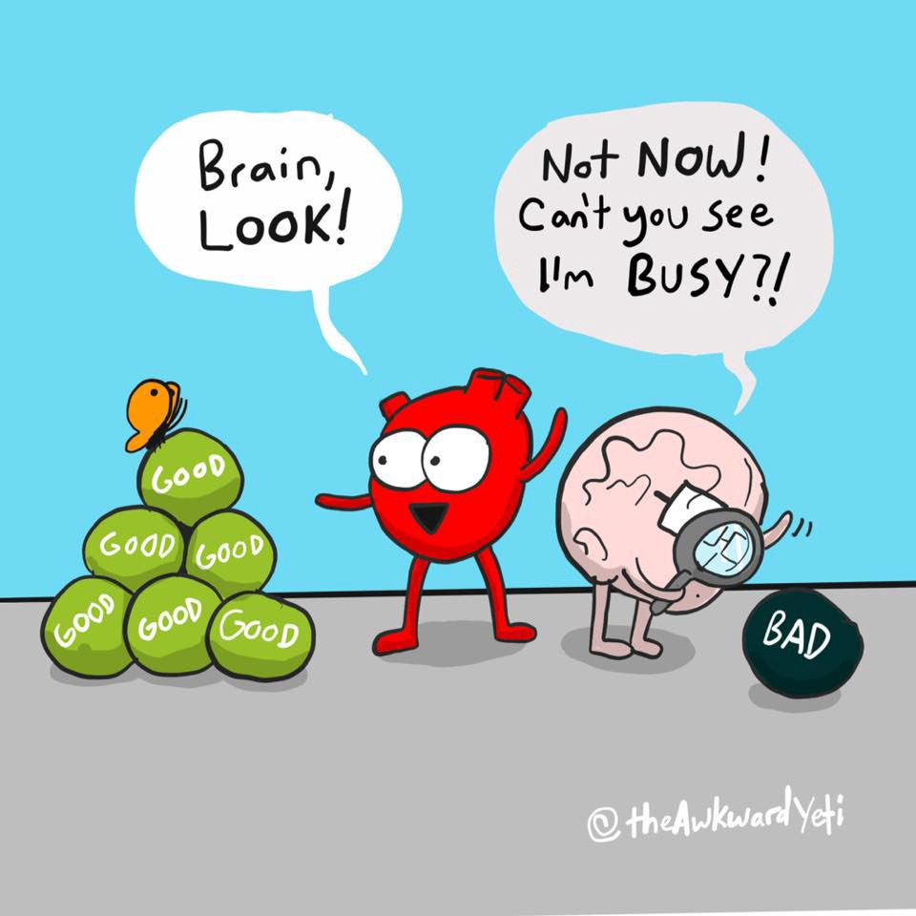

Slide 8
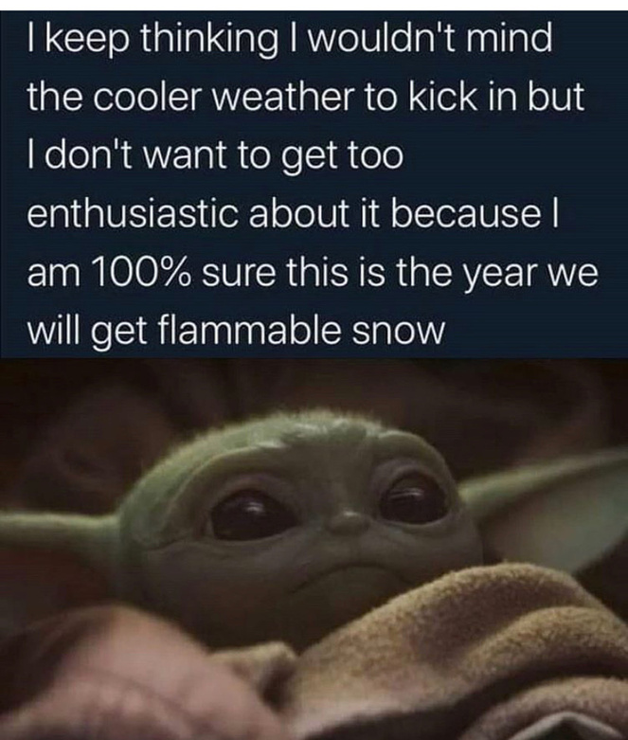

Slide 9
Attitudes
FOUR
Grumpy - I'm not getting what I want
Greedy - I want more
Gross - I don't like how I feel
Grateful - I've got what I need

Slide 10
Gratitude
gives you life.

Slide 11
Gratitude
is giving thanks and passing that sense of appreciation along.

Slide 12
Training yourself to see GOD’s blessing in the everyday things trains you to give glory
in all things.
God

Slide 13
Then the whole community of Israel set out from Elim and journeyed into the
wilderness of Sin, between Elim and Mount Sinai. They arrived there on the fifteenth day of the second month, one month after leaving the land of Egypt.
Exodus 16:1
New Living Translation

Slide 14
“If only the Lord had killed us back in Egypt,” they moaned. “There we sat around pots filled with meat and ate all the bread we wanted. But now you have brought us into this wilderness to starve us all to death.”
Exodus 16:3
New Living Translation

Slide 15
Good 'Ole Days

Slide 16
Then the Lord said to Moses, “Look, I’m going to rain down food from heaven for you. Each day the people can go out and pick up as much food as they need for that day."
Exodus 16;4
New Living Translation

Slide 17


God isn't out to get you.
He's out to give you
His best.

Slide 18
God takes care of His children at all times, especially hard times.

Slide 19
Then Moses said to Aaron, “Announce this to the entire community of Israel: ‘Present yourselves before the Lord, for he has heard your complaining.’”
Exodus 16;9
New Living Translation

Slide 20
God is faithful to us even when we are unfaithful
to Him.

Slide 21
And as Aaron spoke to the whole community of Israel, they looked out
toward the wilderness. There they could see the awesome glory of the Lord in the cloud.
Exodus 16;10
New Living Translation

Slide 22
"I have heard the Israelites’ complaints. Now tell them, ‘In the evening you will have meat to eat, and in the morning you will have all the bread you want. Then you will know that I am the Lord your God.’”
Exodus 16;12
New Living Translation

Slide 23
THANKGETTING
versus
THANKGIVING

Slide 24
Many seek the hand of God, but few seek His
face.
-Anonymous

Slide 25
"Much of contemporary Christianity makes God out to be our Best friend. And He is –But He’s so much more than that…We don’t need a convenient, compact God. We need the one who causes us to fall to our knees, who leaves us speechless,

Slide 26
...who makes our eyes shine with His fire and causes us to depart as changed persons.
And we need that God every moment of every day. We need to rediscover our need for God.”
David Jeremiah - My Heart's Desire.

Slide 27
No one like you, Oh Lord; you are great, and your name is mighty in power. Who should not revere you, O kinds of the nations. This is your due.
Jeremiah 10:6-7
New Living Translation

Slide 28
When the dew evaporated, a flaky substance as fine as frost blanketed the ground.
Exodus 16:14
New Living Translation

Slide 29
But when they measured it out, everyone had just enough. Those who gathered a lot had nothing left over, and those who gathered only a little had enough. Each family had just what it needed.
Exodus 16:18
New Living Translation

Slide 30
  No paycheck
  No jobs
  No Clicklist/Grocery Pick-up

Slide 31
Then Moses told them, “Do not keep any of it until morning.”
But some of them didn’t listen and kept some of it until morning. But by then it was full of maggots and had a terrible smell. Moses was very angry with them.
Exodus 16:19-20
New Living Translation

Slide 32
Put on Your
Glasses
Gratitude

Slide 33
Moses said to Aaron, “Get a jar and fill it with two quarts of manna.
Then put it in a sacred place before the Lord to preserve it for all future
generations.”
Exodus 16:32
New Living Translation

